Slide 1

Web scraping to gain company insights
14/02/2024

Slide 2

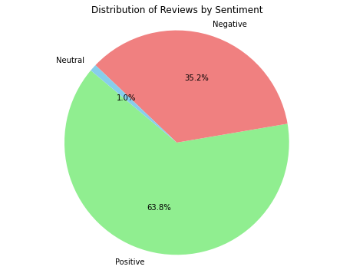
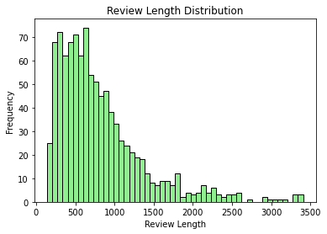
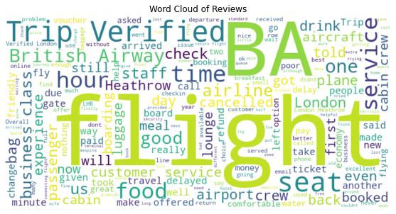
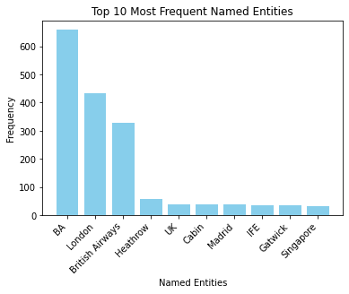
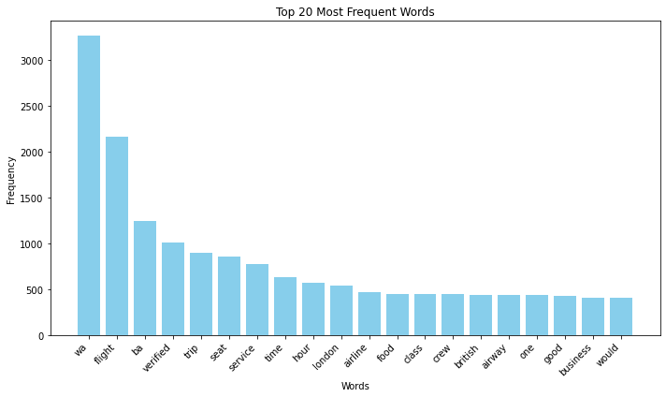
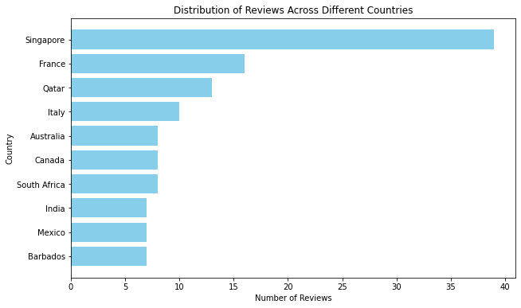
638
No. of Positive Reviews
352
No. of Negative Reviews
1000
Total Negative Reviews
Focus on: Based on the reviews, potential improvements include enhancing customer service, upgrading in-flight experiences, improving punctuality, optimizing baggage handling, streamlining the boarding process, and overall satisfaction.
According to the sentiment analysis, the best service was Seats Comfort.
The Majority of Reviews are from Singapore with 39 reviews.
Most Reviews determine that customers are generally Happy.

